Slide 1
Differential Privacy Preserving Deep Learning
Xintao Wu
University of Arkansas
July 27, 2018

Slide 2
Outline
Differential Privacy
Motivation and Definition
Mechanisms
Deep Learning
Differential Privacy Preserving Deep Learning
Application
Conclusion

Slide 3


Differential Privacy [Dwork, TCC06]
Data owner
Data miner
name | sex | age | disease | salary
Ada | F | 18 | cancer | 25k
Bob | M | 25 | heart | 110k
Cathy | F | 20 | cancer | 70k
Dell | M | 65 | flu | 65k
Ed | M | 60 | cancer | 300k
Fred | M | 24 | flu | 20k
George | M | 22 | cancer | 45k
Harry | M | 40 | flu | 95k
Irene | F | 45 | heart | 70k
Query f
Query result + noise
Cannot be used to derive whether any individual is included in the database

Slide 4
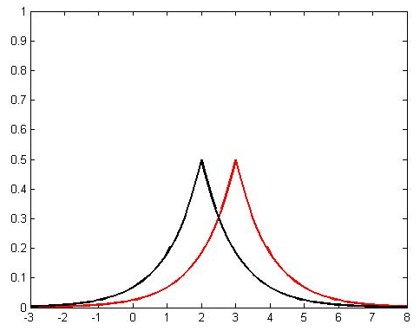
Differential Guarantee
name | disease
Ada | cancer
Bob | heart
Cathy | cancer
Dell | flu
Ed | cancer
Fred | flu
K
f count(#cancer)
f(x) + noise
3 + noise
name | disease
Ada | cancer
Bob | heart
Cathy | cancer
Dell | flu
Ed | cancer
Fred | flu
f count(#cancer)
K
f(x’) + noise
2 + noise
achieving Opt-Out

Slide 5
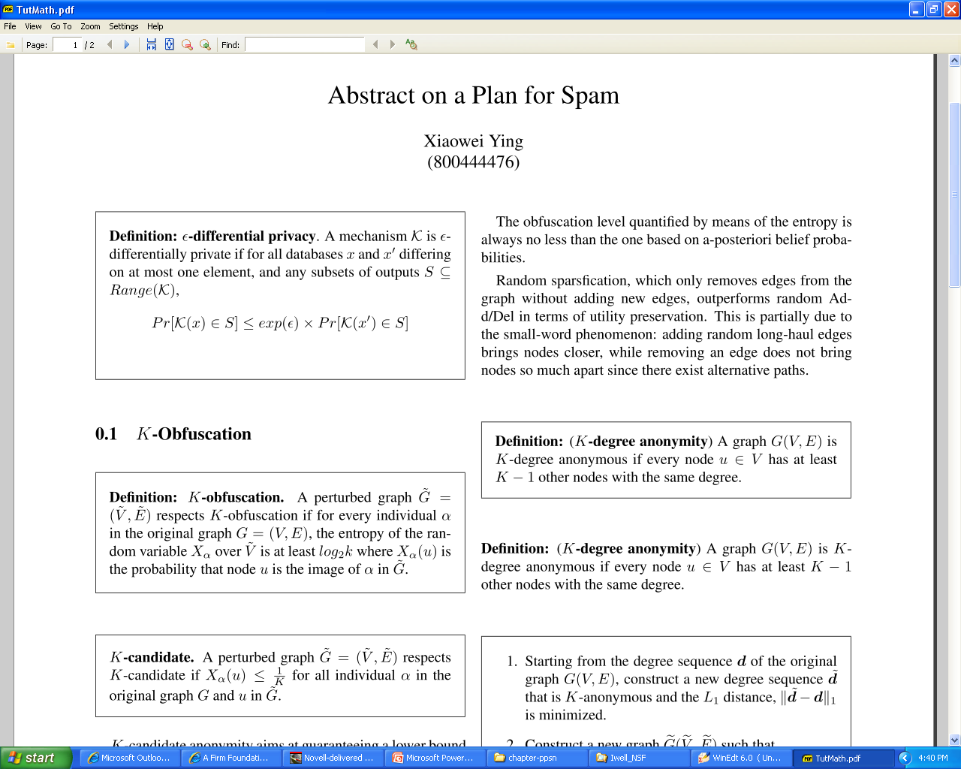
Differential Privacy
ε is a privacy parameter: smaller ε = stronger privacy

Slide 6
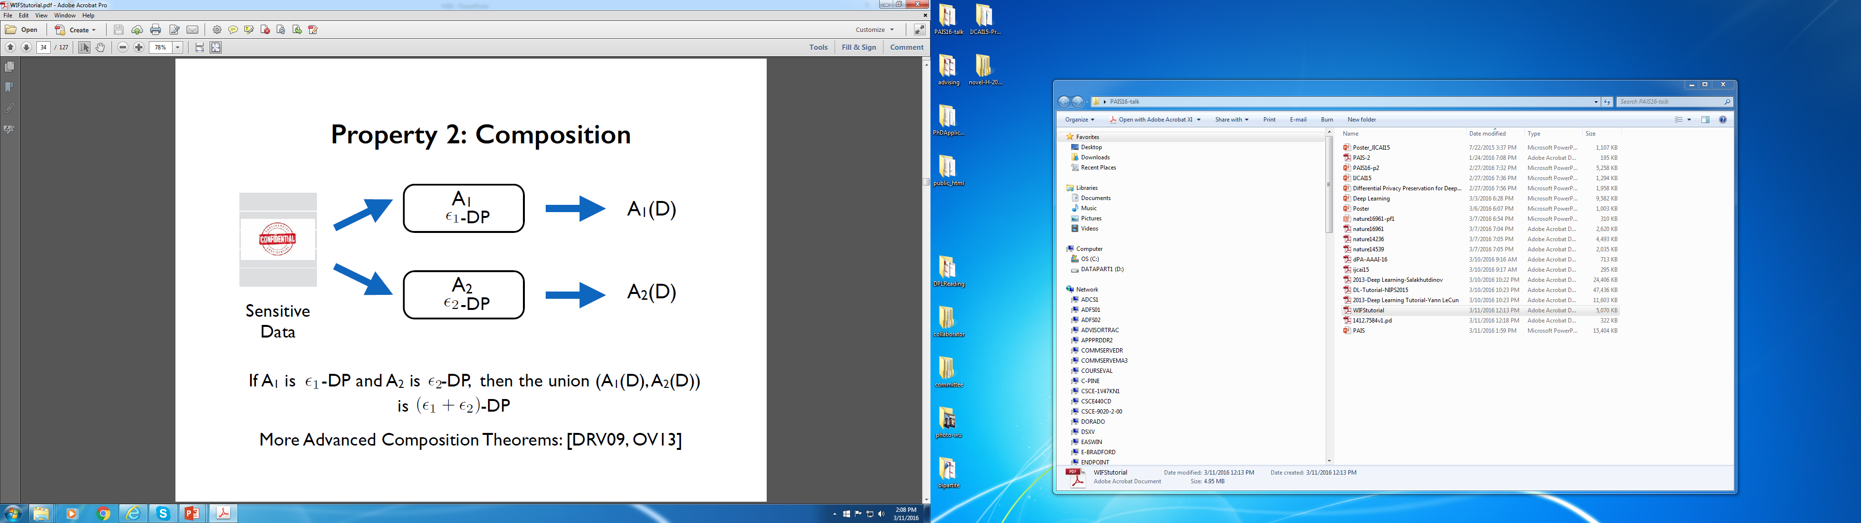
Composition Theorem
Complex functions or data mining tasks can be decomposed to a sequence of simple functions.
[Chaudhuri & Sarwate]

Slide 7
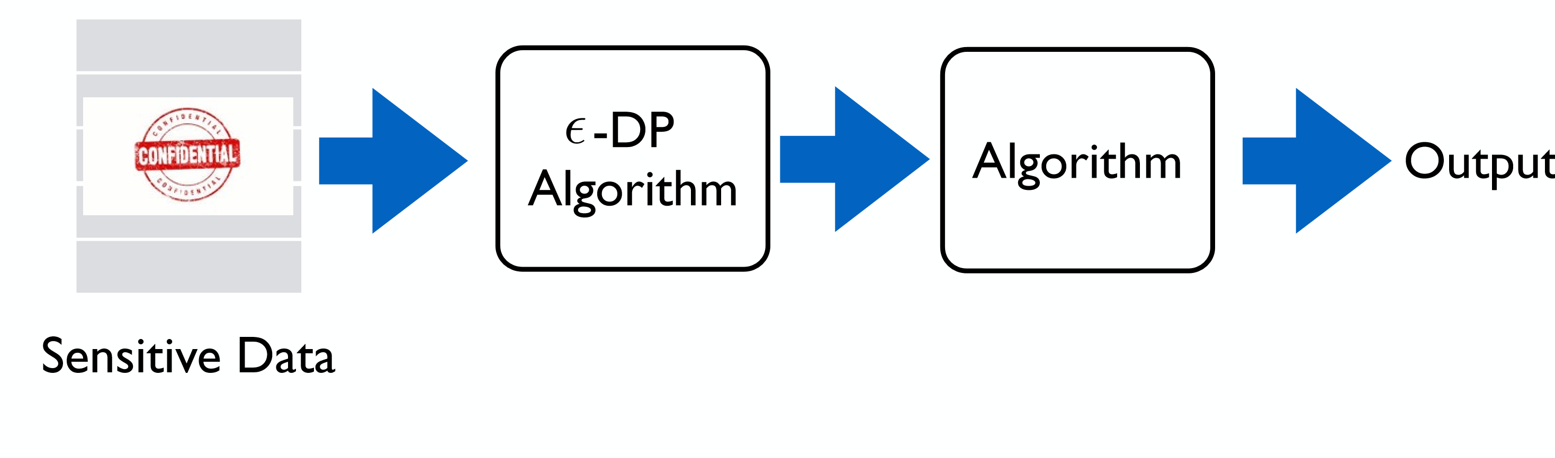
Postprocessing Invariance
[Chaudhuri & Sarwate]

Slide 8
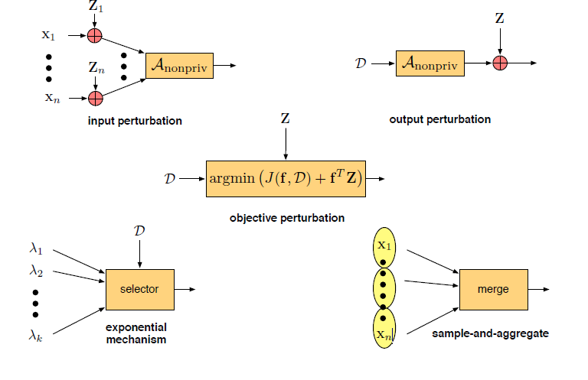
DP Mechanisms
[Chaudhuri & Sarwate]

Slide 9
Differential Privacy
Mechanisms to Achieve Differential Privacy
Applications of Differential Privacy
Data Collection
Data Streams
Logistic Regression
Stochastic Gradient Descents
Recommendation
Spectral Graph Analysis
Causal Graph Discovery
Embedding
Deep Learning

Slide 10
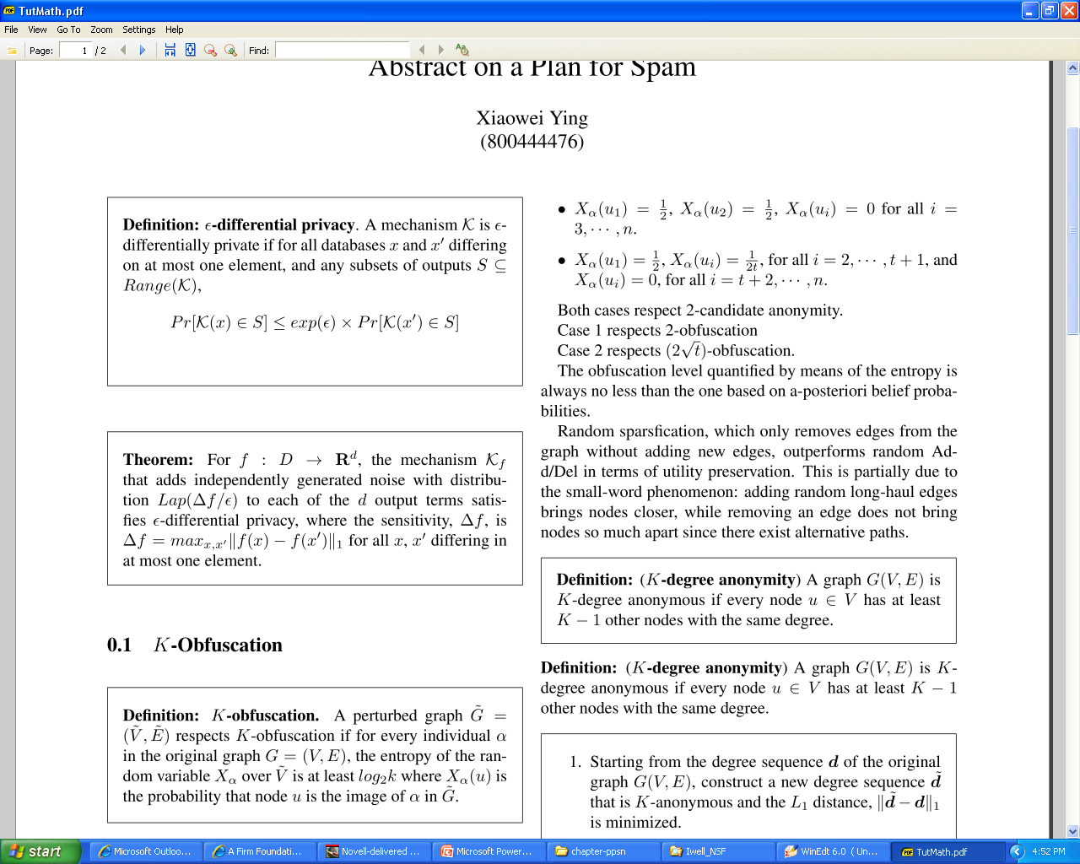
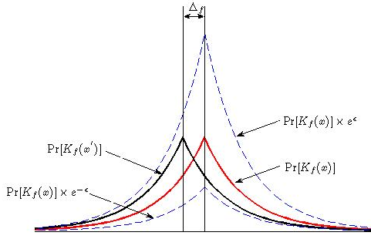
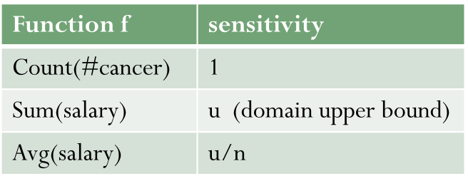
Output Perturbation

Slide 11
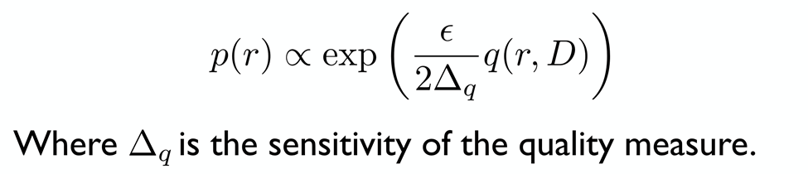
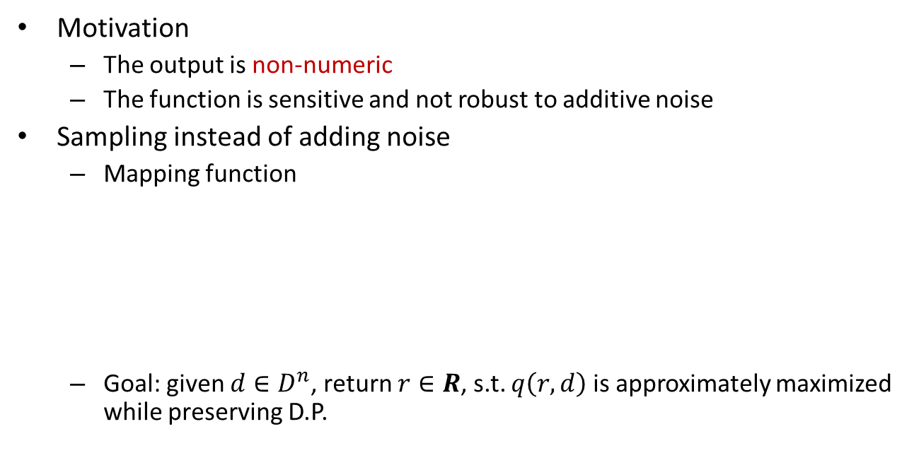
Exponential Mechanism
Motivation
The output is non-numeric
The function is sensitive and not robust to additive noise
Sampling instead of adding noise
Mapping function
Goal: given $d∈D^{n}$, return $r∈R$, s.t. $q\left(r,d\right)$is approximately maximized while preserving D.P.
(McSherry FOCS07)

Slide 12
Input Perturbation
Randomized response
Each individual sends a locally perturbed data to the untrusted server
The server derives estimates of population
Achieve strong local differential privacy
When DP is enforced, the server could not tell the original individual value from the perturbed one

Slide 13
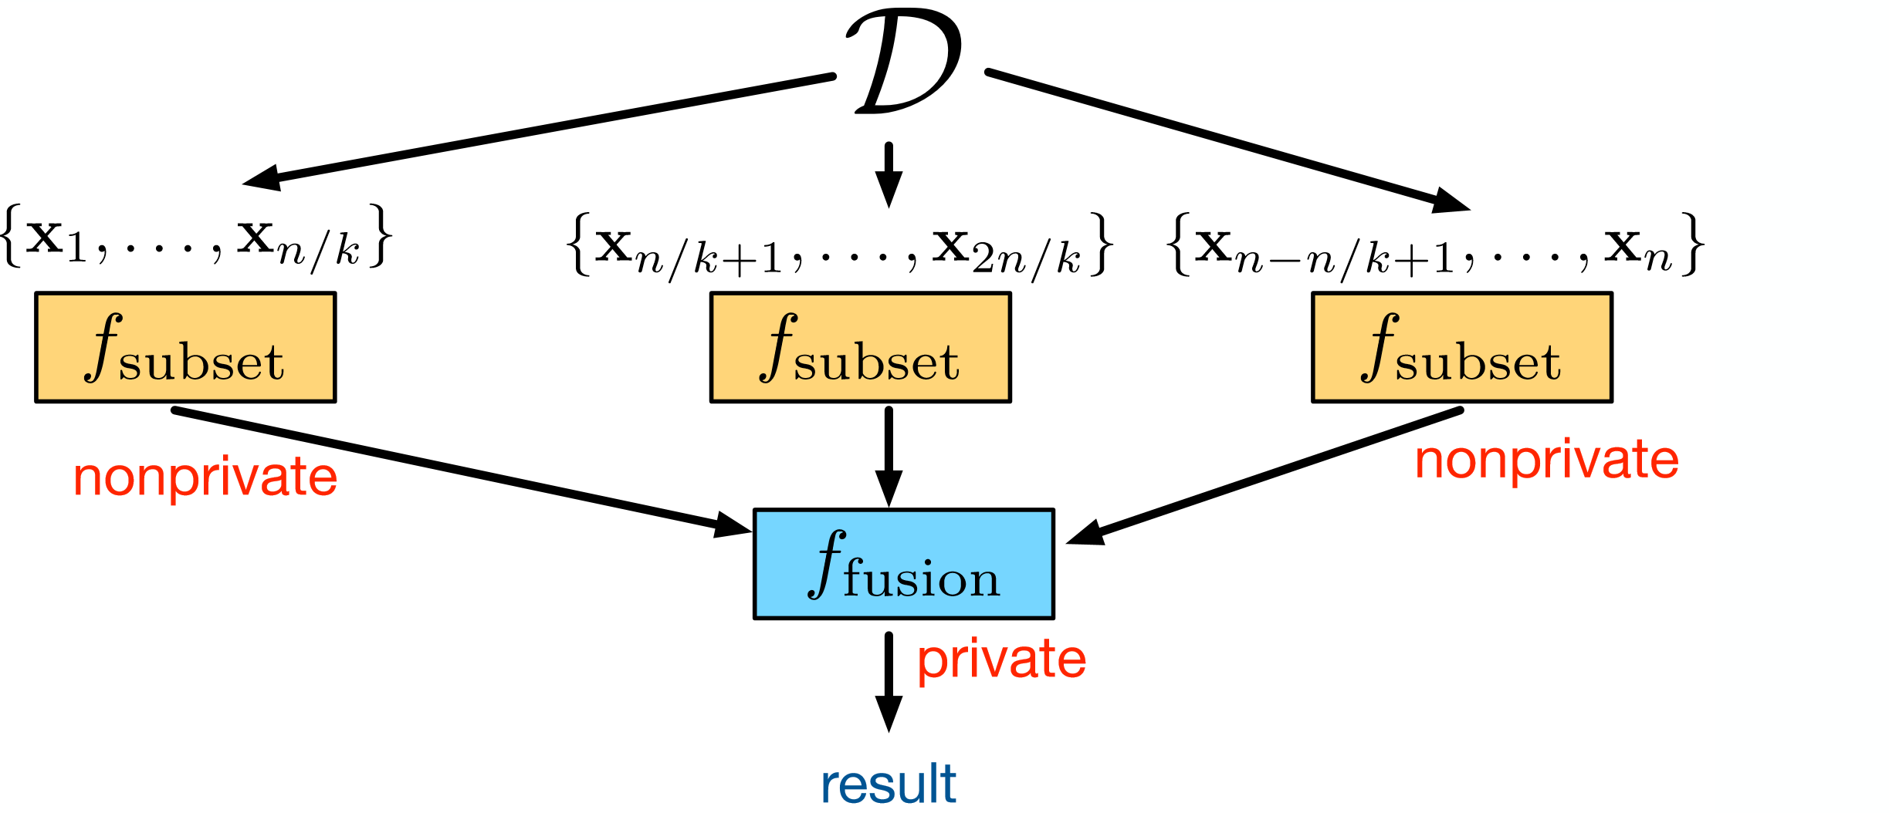
Sample and aggregate
[Chaudhuri & Sarwate]

Slide 14
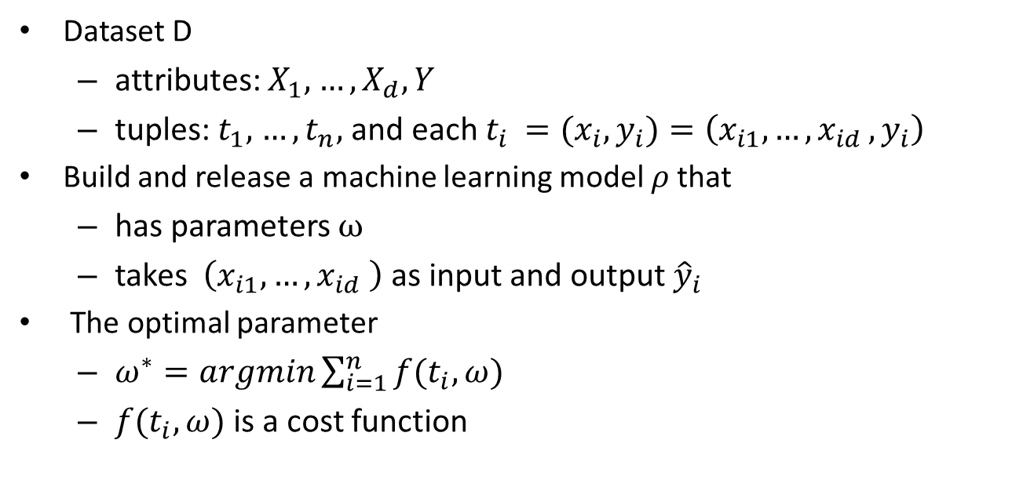
Machine Learning with Optimization
Dataset D
attributes: $X_{1},$ $…,X_{d},Y$
tuples: $t_{1},$ $…,t_{n},$ and each $t_{i }={(x}_{i},y_{i})=\left(x_{i1}, …{,x}_{id},y_{i}\right)$
Build and release a machine learning model $ρ$that
has parameters $ω$
takes $\left(x_{i1}, …{,x}_{id} \right)$ as input and output ${\hat{y}}_{i}$
The optimal parameter
$ω^{∗}=argmin\sum_{i=1}^{n}{f(t_{i},ω)}$
$f(t_{i},ω)$ is a cost function

Slide 15
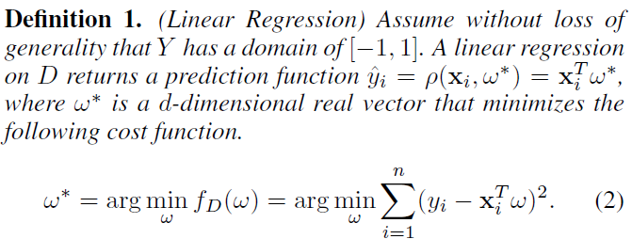
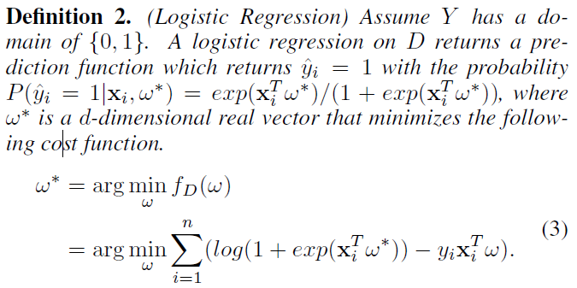
Linear Regression and Logistic Regression
Regression model
Objective function

Slide 16
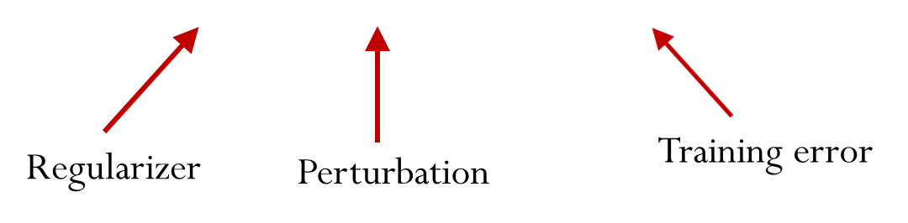
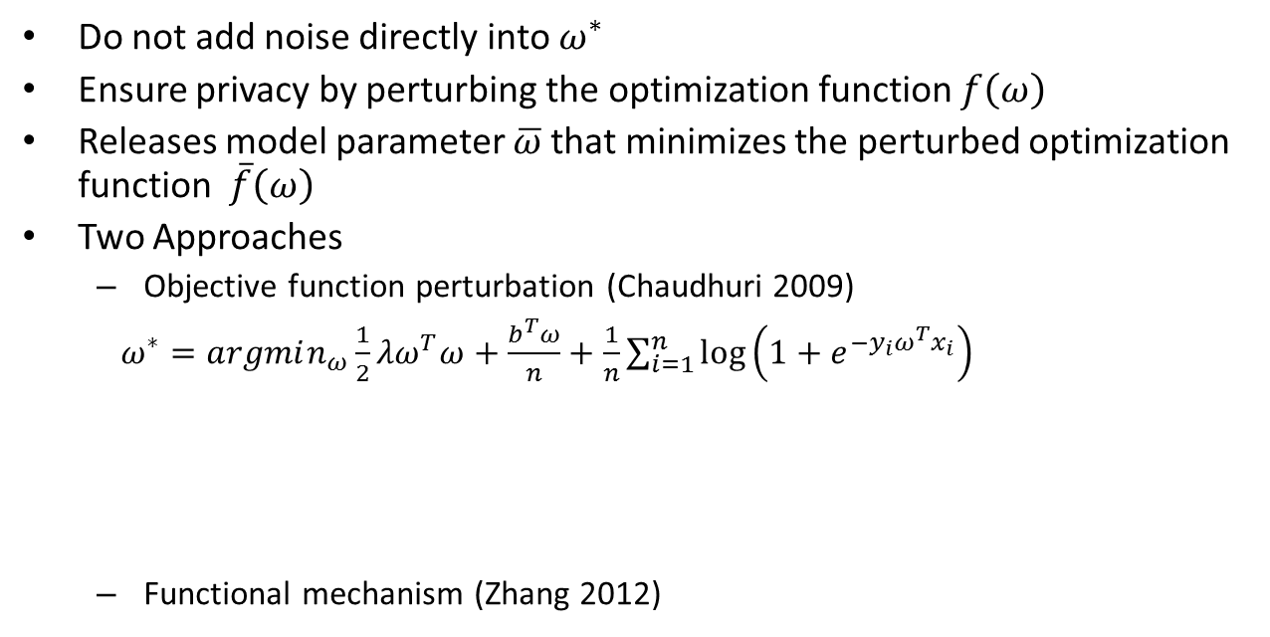
Objective Perturbation
Do not add noise directly into $ω^{∗}$
Ensure privacy by perturbing the optimization function $f\left(ω\right)$
Releases model parameter $\overline{ω}$that minimizes the perturbed optimization function $\overline{f}\left(ω\right)$
Two Approaches
Objective function perturbation (Chaudhuri 2009)
$ω^{∗}=argmin_{ω}\frac{1}{2}λω^{T}ω+\frac{b^{T}ω}{n}+\frac{1}{n}\sum_{i=1}^{n}{\log\left(1+e^{−y_{i}ω^{T}x_{i}}\right)}$
Functional mechanism (Zhang 2012)

Slide 17
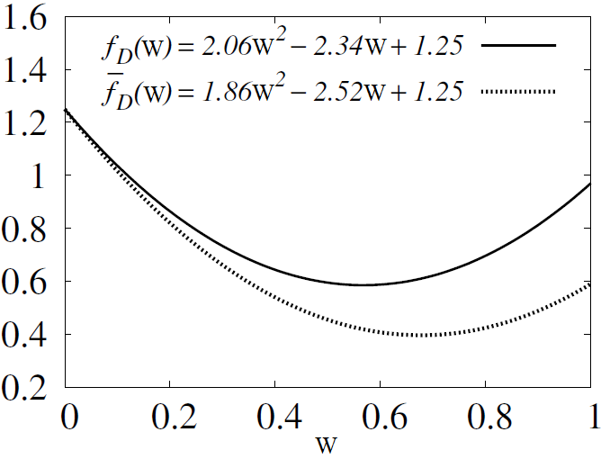
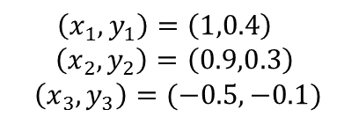
Example
$$\left(x_{1},y_{1}\right)=\left(1,0.4\right)$$
$\left(x_{2},y_{2}\right)=\left(0.9,0.3\right)$
$\left(x_{3},y_{3}\right)=(−0.5,−0.1)$
Objective function for linear regression and its noisy version obtained by functional mechanism

Slide 18
Outline
Differential Privacy
Motivation and Definition
Mechanisms
Deep Learning
Differential Privacy Preserving Deep Learning
Application
Conclusion

Slide 19
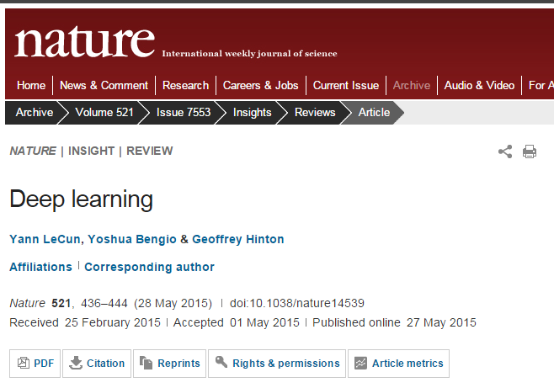

Slide 20
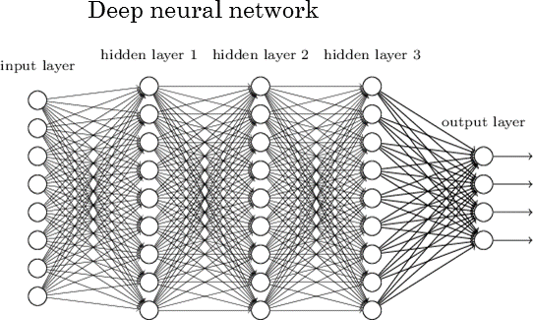
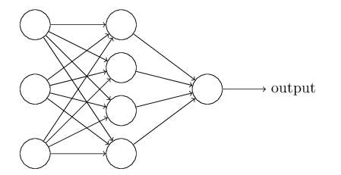
Deep Learning
Machine learning algorithms based on multiple levels of representation/abstraction
automatically learning good features or representations
not simply using human-designed representations or input features
Neural Network

Slide 21
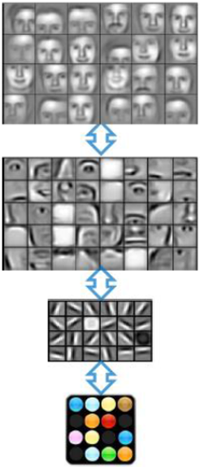
Deep Learning
3rd Layer
“Objects”
1st Layer
“Edges”
Pixels
[Andrew Ng]

Slide 22
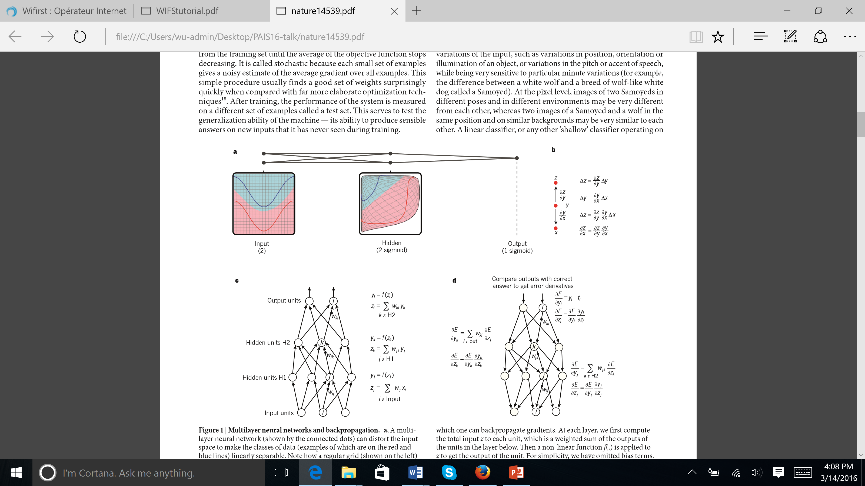
Multilayer Neural Network
Loss function E defined for the whole NN or each layer in the stacked NN
non-linear activation func.
eg, ReLU, Sigmoid,…
Affine transformation
e.g. weighted sum
[LeCun, Bengio & Hinton]
Notes:
At each layer, we first compute the total input z to each each unit, which is a weighted sum of the outputs of the units in the layer below. Then a non-linear function is applied to z to get the output of the unit. The nonlinear function includes te rectified linear unit or sigmoids function.

Slide 23
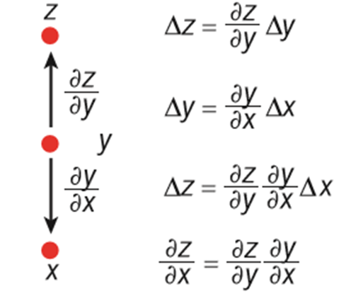
Back Propagation
[LeCun, Bengio & Hinton]
Notes:
The chain rule of derivatives.
At each hidden layer, we compute the error derivates with respect to the output of each unit, which is a weighted sum of the error derivatives with respect to the total inputs to the units in the layer above.

Slide 24
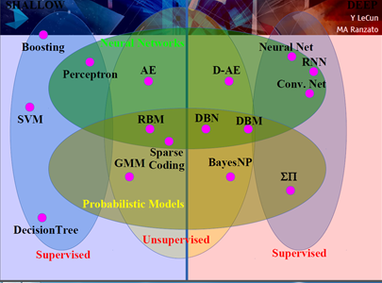
Deep Learning
[LeCun & Ranzato]

Slide 25
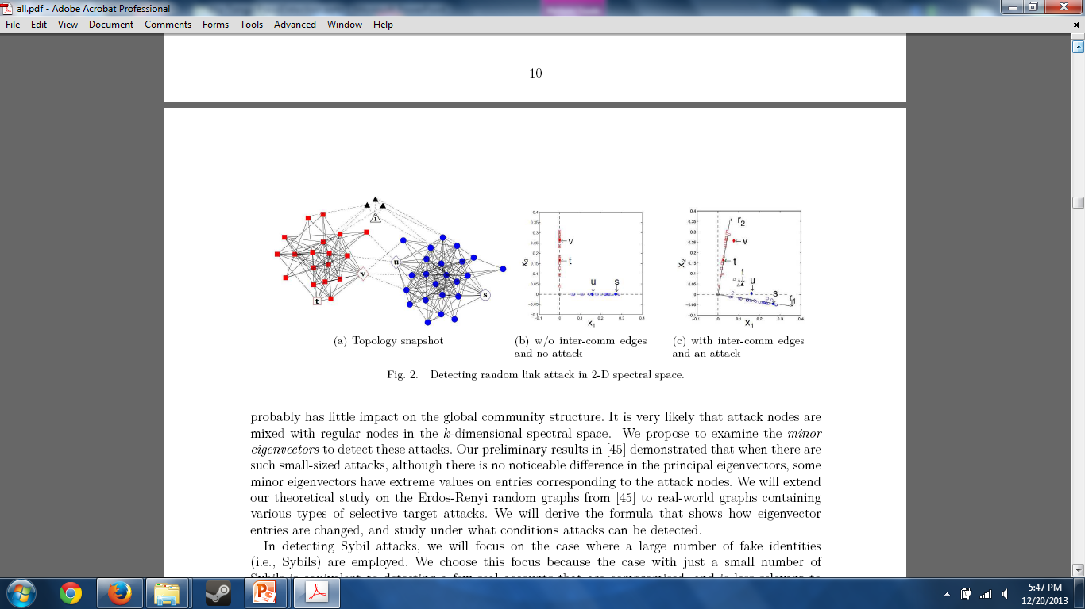
Spectral Graph Analysis for Cyber Fraud Detection
Reviews
Ratings
Ranks
Bot-committed
Money-motivated

Slide 26
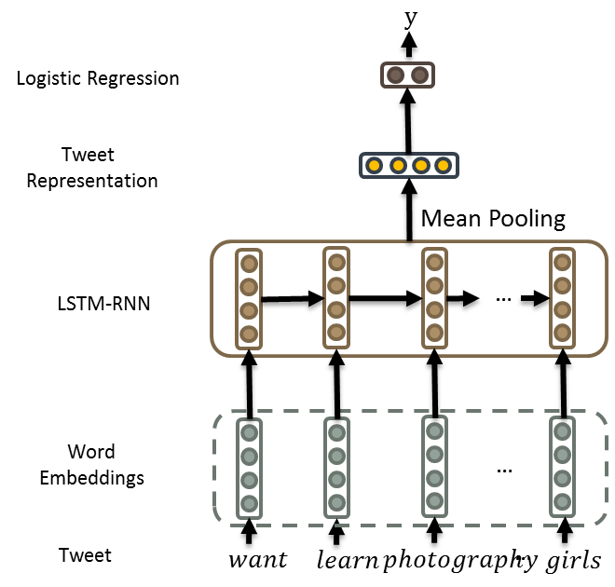
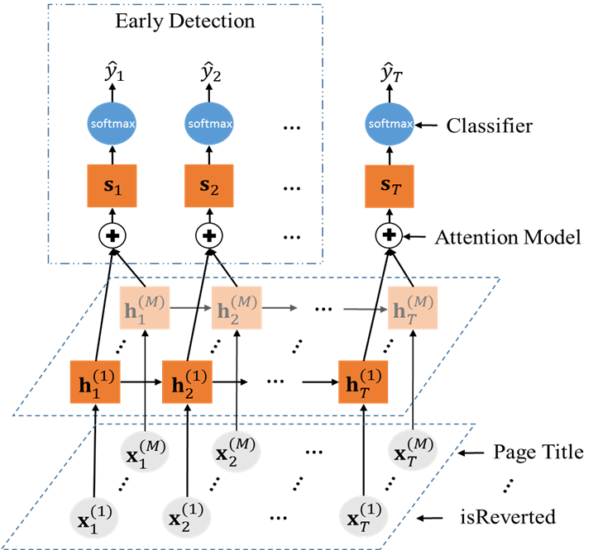
Deep Learning

Slide 27
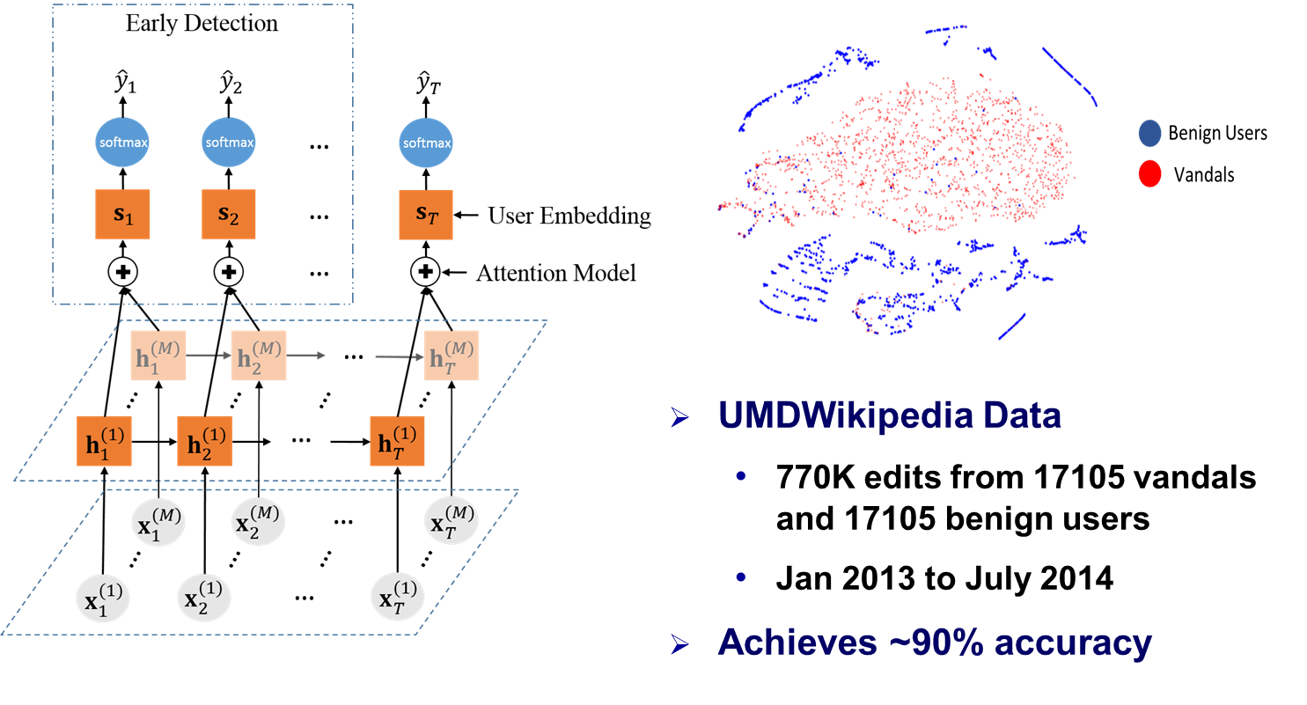
Vandal Detection

Slide 28

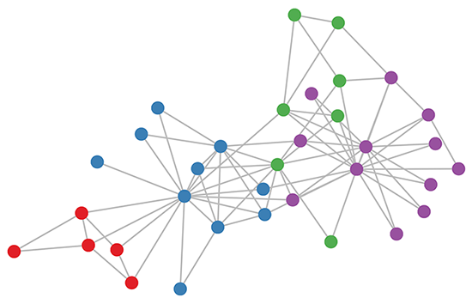
Network Embedding
Vertex Representations
(low dimensional features)
Graph G
Network Embedding
Data Mining Algorithms
k
Vertex Classification
Link Prediction
Clustering
Anomaly Detection
Visualization
……
DeepWalk
node2vec
LINE
Laplacian Eigenmaps
HOPE
…
|V|

Slide 29
Outline
Differential Privacy
Motivation and Definition
Mechanisms
Deep Learning
Differential Privacy Preserving Deep Learning
Application
Conclusion

Slide 30
DP-Preserving Deep Learning
A non-trivial task due to the multi-layer structure, activation function, loss function
State-of-the-art
Distributed DP deep learning (Shokri & Shamatikov, CCS 2015)
pSGD (Abadi et al., CCS2016)
AdLM – Adaptive Laplace Mechanism (Phan et al., ICDM2017)
dPAs – Auto-encoder (Phan et al., AAAI2016)
pCDBNs - Convolutional Deep Belief Networks (Phan et al., ML 2017)

Slide 31
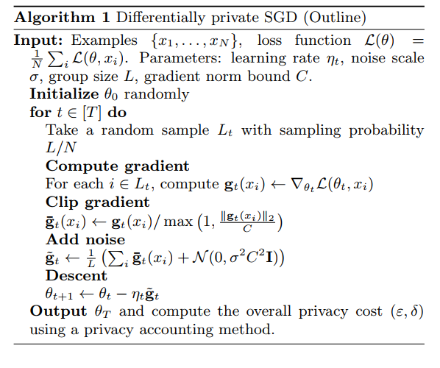
pSGD (Abadi et al., CCS2016)
Private stochastic gradient descent algorithm and privacy accountant
Dependent on the number of epochs
Notes:
Algorithm 1 outlines our basic method for training a model with parameters θ by minimizing the empirical loss function L(θ). At each step of the SGD, we compute the gradient ∇θL(θ, xi) for a random subset of examples, clip the `2 norm of each gradient, compute the average, add noise in order to protect privacy, and take a step in the opposite direction of this average noisy gradient. At the end, in addition to outputting the model, we will also need to compute the privacy loss of the mechanism based on the information maintained by the privacy accountant.

Slide 32
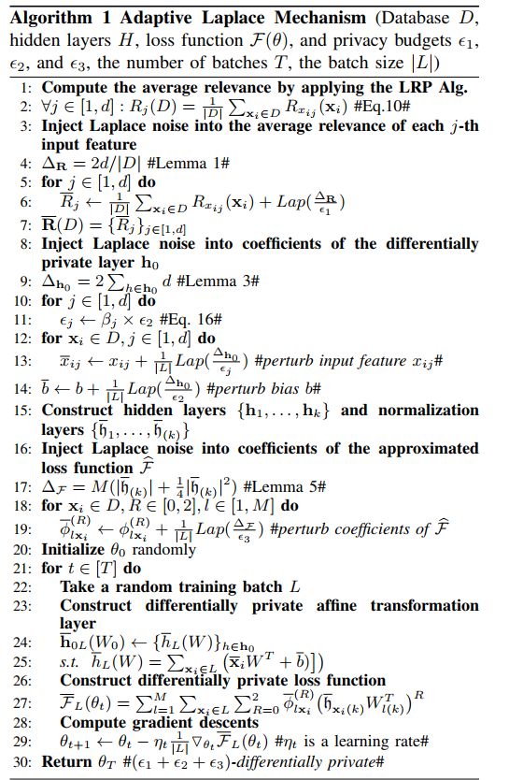
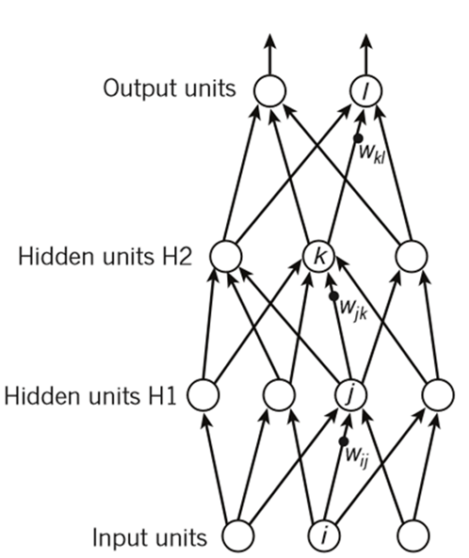

AdLM – Adaptive Laplace Mechanism (Phan et al., ICDM2017)
Add adaptive laplace noise to affine transformation in the input layer
Apply functional mechanism by adding noise to approximation of loss function in the output layer
Independent on the number of epochs

Slide 33
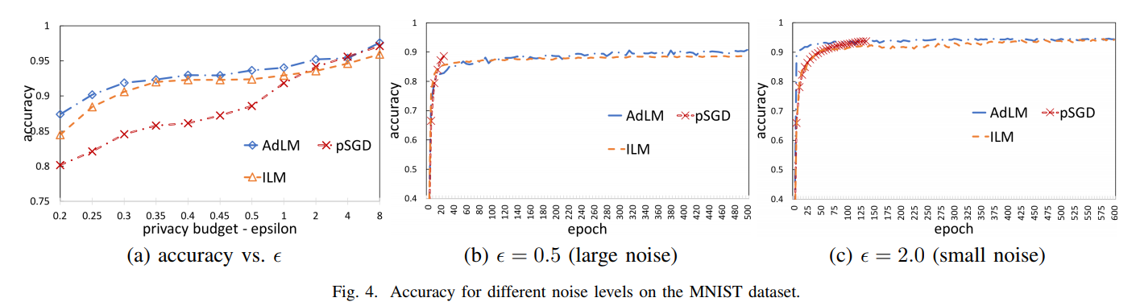
pSGD vs. AdLM
Handwriting Digit Recognition – MNIST dataset
Notes:
To further demonstrate the ability to work on large-scale datasets, we conducted additional experiments on the well-known MNIST dataset.
We compare our model with the private stochastic gradient descent algorithm, denoted pSGD, from Albadi et al., CCS’16.
We can see that our model pCDBN outperforms the pSGD in terms of prediction accuracies with small values of the privacy budget.
This is a substantial result, since smaller values of epsilon enforce a stronger privacy guarantee of the model.
The right-hand side figure demonstrates the benefit of being independent of the number of training epochs in consuming the privacy budget of our mechanism.
In this experiment, epsilon is set to 0.5, i.e., large injected noise.
The pSGD achieves higher prediction accuracies after using a small number of training epochs, i.e., 88.75% after 18 epochs, compared with the pCDBN.
More epochs cannot be used to train the pSGD, since it will violate the privacy protection guarantee.
Meanwhile, our model, the pCDBN, can be trained with an unlimited number of epochs.
After 162 epochs, the pCDBN outperforms the pSGD in terms of prediction accuracy, with 91.71% compared with 88.75%.

Slide 34
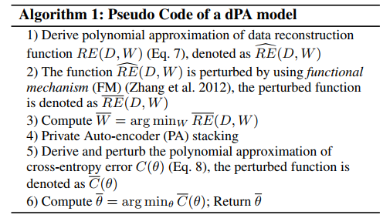
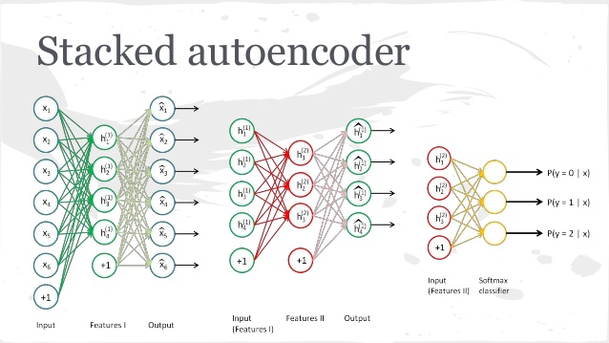
dPAs – Auto-encoder (Phan et al., AAAI2016)
Apply functional mechanism by adding noise to polynomial approximation of
reconstruction error of input and hidden layers
cross-entropy error function of output layer
Based on Taylor expansion
Independent on the number of epochs

Slide 35
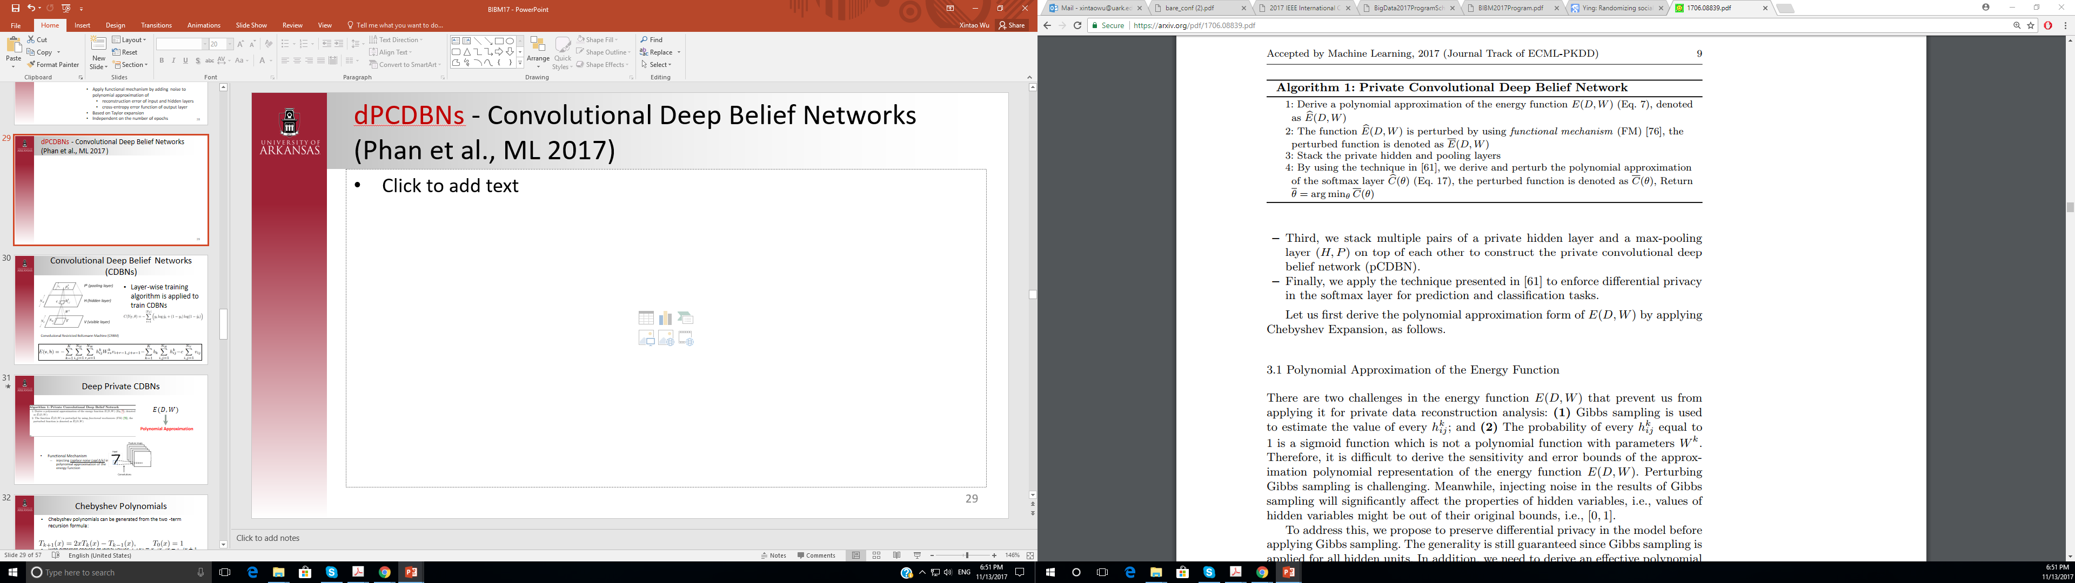
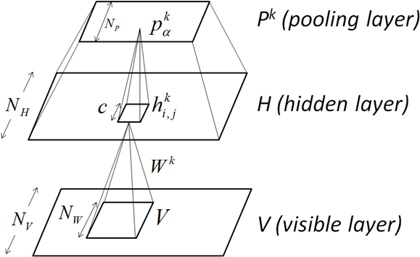
pCDBNs - Convolutional Deep Belief Networks (Phan et al., ML 2017)
Apply functional mechanism by adding noise to polynomial approximation of
reconstruction error of input and hidden layers
cross-entropy error function of output layer
Based on Chebyshev polynomial approximation
Independent on the number of epochs

Slide 36
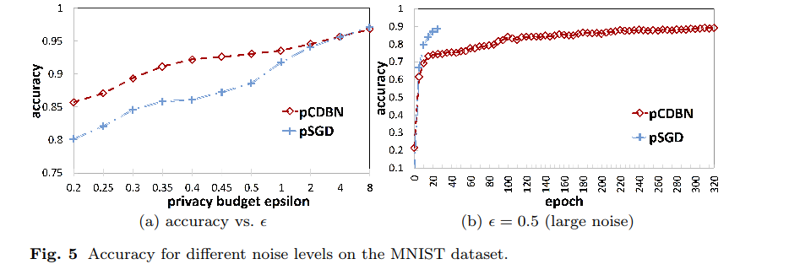
pSGD vs. pCDBN
Handwriting Digit Recognition – MNIST dataset
Notes:
To further demonstrate the ability to work on large-scale datasets, we conducted additional experiments on the well-known MNIST dataset.
We compare our model with the private stochastic gradient descent algorithm, denoted pSGD, from Albadi et al., CCS’16.
We can see that our model pCDBN outperforms the pSGD in terms of prediction accuracies with small values of the privacy budget.
This is a substantial result, since smaller values of epsilon enforce a stronger privacy guarantee of the model.
The right-hand side figure demonstrates the benefit of being independent of the number of training epochs in consuming the privacy budget of our mechanism.
In this experiment, epsilon is set to 0.5, i.e., large injected noise.
The pSGD achieves higher prediction accuracies after using a small number of training epochs, i.e., 88.75% after 18 epochs, compared with the pCDBN.
More epochs cannot be used to train the pSGD, since it will violate the privacy protection guarantee.
Meanwhile, our model, the pCDBN, can be trained with an unlimited number of epochs.
After 162 epochs, the pCDBN outperforms the pSGD in terms of prediction accuracy, with 91.71% compared with 88.75%.

Slide 37
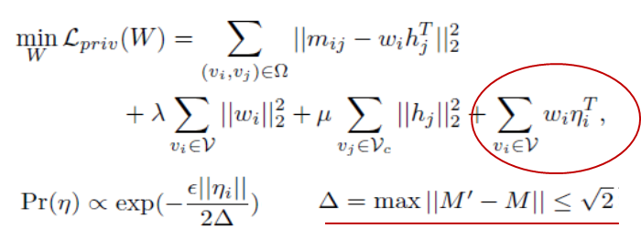
DPNE: Differentially Private Network Embedding
Construct M for DeepWalk as matrix factorization
Objective perturbation
Solve with SGD
Output private vertex representations
Further analysis (e.g. vertex classification)
Xu et al. PAKDD18

Slide 38
Experiment
Vertex classification with varying ε

Slide 39
Outline
Differential Privacy
Motivation and Definition
Mechanisms
Deep Learning
Differential Privacy Preserving Deep Learning
Application
Conclusion

Slide 40
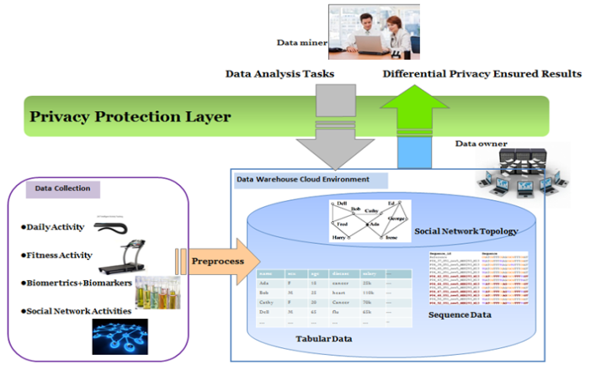
Preserving Privacy in Semantic Mining of Activity, Social, and Health Data (NIH R01GM103309)

Slide 41
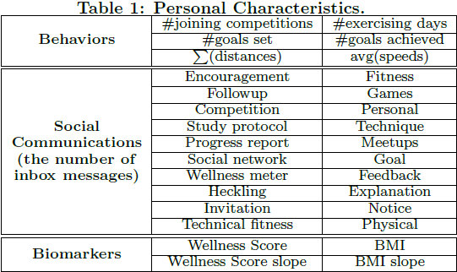
Dataset, Features, and Task
YesiWell dataset
254 users
Oct 2010 – Aug 2011
10 million data points
BMI
Wellness Score
Prediction Task: Try to predict whether a YesiWell user will increase or decrease exercises in the next week compared with the current week.
Notes:
We have 254 users.
We consider 30 individual features in total including physical activities, social communications, and biomarkers.
In this study, we try to predict whether a YesiWell user will increase or decrease exercises in the next week compared with the current week.

Slide 42
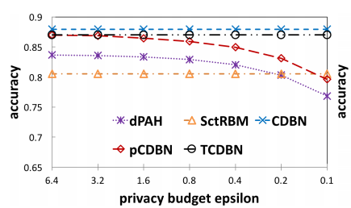
Human Behavior Prediction
Do not enforce differential privacy
CDBN, SctRBM
Truncated convolutional deep belief network (TCDBN)
Do enforce differential privacy
Deep private auto-encoder (dPAH)
pCDBN
Notes:
We compare our model with various competitive models, including non-enforcing differential privacy model and enforcing differential privacy model.
CDBN, SctRBM, Truncated Convolutional Deep Belief Network, and Deep private auto-encoder (dPAH).
This Figure shows the prediction accuracy of each algorithm as a function of the dataset cardinality.
There is a gap between the prediction accuracy of pCDBN and the original convolutional deep belief network (CDBN).
However, the gap dramatically gets smaller with the increase of the dataset cardinality.
In addition, our pCDBN outperforms the state-of-the-art dPAH in most of the cases, and the results are statistically significant.
Our algorithm also is significantly better than the SctRBM when the sampling rate goes just a bit higher, i.e., > 0.2 or > 0.3.
This is a remarkable result.
The other Figure illustrates the privacy budget epsilon and the prediction accuracy.
Our model is relatively robust against the change of epsilon.
The pCDBN model is competitive even with privacy non-enforcing models.

Slide 43
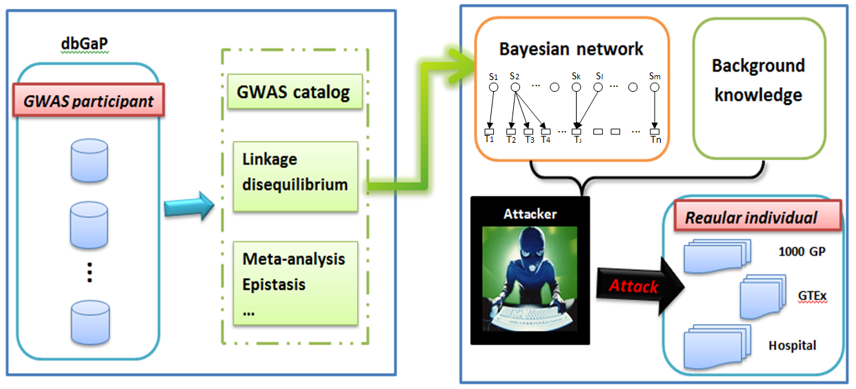
Genetic Privacy
(NSF 1502273 & 1523115)

Slide 44
Conclusion
Differential privacy mechanisms for deep learning
Adding noise to stochastic gradients is generally feasible (when the number of epoches is small)
Functional mechanism is effective (when the number of neurons is small) but derivation of approximations is needed
Other mechanisms can also be explored
DP-preserving deep learning is challenging
Complicated objective functions, e.g., without finite polynomial representations
Different structures and tons of parameters
Influence of dropout and minibatch
Accuracy bound

Slide 45


Acknowledgement
Thanks to my collaborators, Hai Phan from NJIT, Dejing Dou from Oregon, and my students Shuhan Yuan, Depeng Xu, and Panpan Zheng.
Thanks for the support from U.S. National Science Foundation (DGE-1523115 and IIS-1502273), National Institute of Health (R01GM103309), and SEEDS at University of Arkansas.

